Slide 1










50% DBE
Reimbursement
PRESENTATION

Slide 2




Agenda
What is the 50% DBE reimbursement form?
Who/what qualifies?
How do I fill out the form?
WHo do I give the form to once its filled out?
All this and more!

Slide 3

What is the 50% DBE reimbursement program?
FINANCIAL ASSISTANCE!
Designed to empower and Support DBE’s!
enhances competitiveness in the marketplace!
Fosters Bisiness growth!
Notes:
The 50% DBE Reimbursement Program is designed to empower and support Disadvantaged Business Enterprises (DBEs), fostering the growth of their businesses and enhancing competitiveness in the marketplace. This initiative approves reimbursement of 50% of the costs incurred for work-related expenses. The financial assistance is targeted at aiding DBEs in covering expenses associated with bidding or completing work on current projects. The program specifies predetermined dollar amounts, with an annual reimbursement cap of $2,500.00 per DBE.

Slide 4


Authority
23 CFR 230: Subpart B – Support Services for Minority, Disadvantaged, and Women Business Enterprises

Slide 5
Approval of the Application is Contingent Upon...
Funds availability
Qualified DBE firms based in Alaska
Submission of a completed application with supporting documents
Notes:
The Approval of the Application is contingent upon if there are any Funds available, if Qualified DBE firm is based in Alaska and if the submission of a completed application has all the required supporting documents.

Slide 6
Who qualifies?
DBE FIRMS ACTIVELY BIDDING ON DOT FWHA FUNDED PROJECTS SUCH AS:
  EMPLOYEES
  OWNERS
  ON-SITE REPRESENTATIVES
DBE’S WITH ALASKA AS THEIR HOME BASE CERTIFICATION
DBE FIRMS REGISTERED ON THE BIDDERS REGISTRATION WEBSITE
Notes:
DBE firms (including employees, owners, or on-site representatives) actively bidding on DOT Federal Highway Administration (FWHA) funded projects or registered on the Bidders Registration are eligible. Only certified DBEs with Alaska as their home base certification can participate in the 50% Reimbursement Program. DBEs certified in states other than Alaska are not eligible, though they can avail of other services provided by the DBE program.

Slide 7
Before Submitting an Application!
CHECK YOUR BIDDERS
REGISTRATION STATUS!
IF YOU ARE NOT REGISTERED, SUBMIT YOUR:
25D-6 PSA CONSULTANT REGISTRATION
25D-6 BIDDERS REGISTRATION
OR
TO DOT.CRO.FORMS@ALASKA.GOV
Notes:
All firms are required to submit a Bidder’s Registration form before an Alaska Department of Transportation and Public Facilities (DOT&PF) project can be awarded. The Bidder Registration form must be submitted to the Civil Rights Officer (CRO) on an annual basis beginning January 1 and is valid thru December 31.

Slide 8
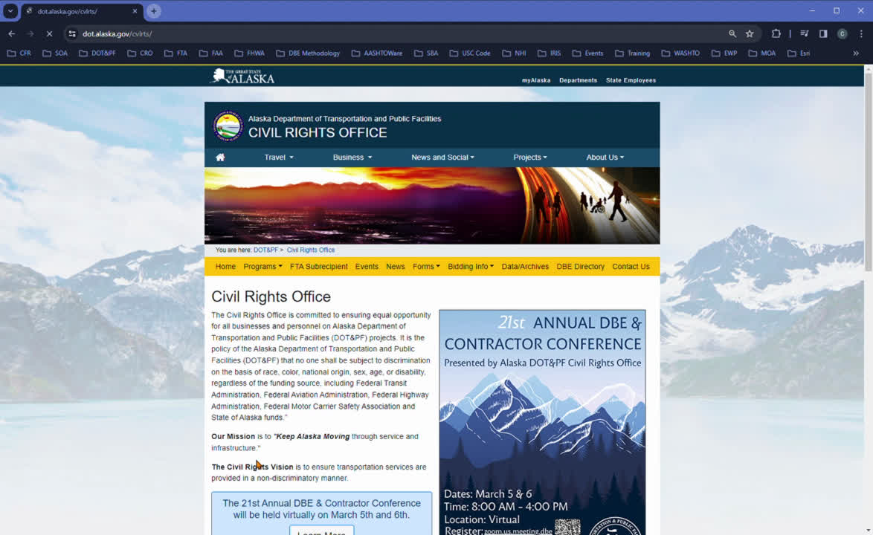

Where to find your Bidders Registration
DEMONSTRATION OF HOW TO SEE IF YOU ARE A REGISTERED BIDDER
HTTPS://DOT.ALASKA.GOV/CVLRTS/BIDREG/BIDREG.CFM

Slide 9
Reimbursement period for FFY2024
THE MAXIMUM REIMBURSEMENT PER QUALIFYING DBE FIRM PER BENIFIT YEAR IS $2,500.00
October 1st 2023
AN ADDITIONAL $2,500.00 MAY BE SUBMITTED AT THE END OF THE FEDERAL FISCAL YEAR (SEPTEMBER 1ST-30TH)IF FUNDS ARE AVAILABLE
to
September 30th 2024
Notes:
The reimbursement period spans from October 1, 2023, to September 30, 2024. Reimbursement submissions after the Federal Fiscal Year period closure (unless otherwise approved) will not be accepted.
The maximum reimbursement per qualifying DBE firm per benefit year is $2,500.00. An additional $2,500.00 may be submitted at the end of the Federal Fiscal Year (September 1-30) if funds are available, but this is not guaranteed.

Slide 10
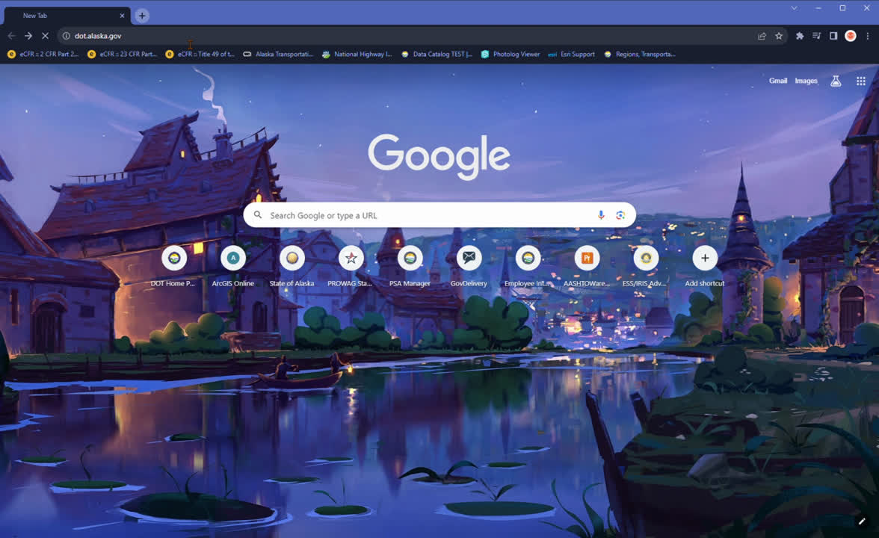
DBE certification number
DEMONSTRATION OF HOW TO FIND YOUR DBE CERTIFICATION NUMBER
HTTPS://DOT.ALASKA.GOV/CVLRTS/DIRECTORY.SHTML
Notes:
To find your DBE Certification number go to DOT&PF Civil Rights Office website and look in the DBE Directory. This short video will walk you through it.

Slide 11

IRIS vendor ID
THE VENDOR ID IS THE ID USED TO LOGINTO IRIS
NEED HELP WITH IRIS?
THE VENDOR HELP DESK IS AVAILABLE:
MONDAY-FRIDAY
FROM 8:00AM - 4:30PM
PHONE NUMBER: 907-465-5555
EMAIL: DOA.DOF.VENDOR.HELPDESK@ALASKA.GOV
HTTPS://DOA.ALASKA.GOV/DOF/VENDOR.HTML

Slide 12
Types of services and applicable expenses
TYPES OF SERVICE:
APPLICABLE EXPENSES:
WHAT IS REIMBURSABLE?
ALASKA SMALL BUSINESS
DEVELOPMENT CENTER (SBDC)
WORKSHOPS AND TRAININGS ARE REIMBURSABLE AT 90% OF THE COST
REGISTRATION FEE
  LEGAL SERVICES
  CONSULTING SERVICES
  MARKETING SERVICES
  HUMAN RESOURCES
  TAX PREPARATIONS
  BUSINESS INSURANCE
  ACCOUNTING SOFTWARE
  FIXED/STANDARD FEE
  HOURLY FEE
  RETAINER FEE
  SOFTWARE FEE
BUSINESS MANAGEMENT
MEMBERSHIP FEES MUST FIT WITHIN TYPE OF INDUSTRY OR DBE BUSINESS
  MONTHLY FEE
  YEARLY FEE
INDUSRY MEMBERSHIP
  CONFERENCE
  NETWORKING
  SEMINAR
  TRAINING
  WORKSHOP
  AIRFARE IF TRAVELING IS LONGER THAN 50 MILES
  MILEAGE IF TRAVELING IN-STATE AND OUT-OF-STATE
  LODGING
  REGISTRATION FEE
PROFESSIONAL DEVELOPMENT
  ANTI-VIRUS PROTECTION
  CYBERSECURITY
  INTERNET
TECH SUPPORT
  MONTHLY FEES
  SOFTWARE FEES
Notes:
Applications are processed on a first-come, first-served basis, subject to meeting stated requirements. The table below outlines major service types with applicable expenses. Notably, trainings provided by Alaska SBDC (Small Business Development Center) are eligible for reimbursement up to 90% of the total invoice for training and/or consultations, contingent on funding availability.

Slide 13
Required supplemental paperwork
OFFICIAL INVOICES
PAYMENT INFORMATION
  NAME OF VENDOR AND LOGO (IF APPLICABLE)
  VENDOR’S ADDRESS
  DATE OF SERVICE
  DBE’S INFORMATION (IF POSSIBLE)
  WEBSITE OR ADDITIONAL INFORMATION IF THE TYPE OF SERVICE IS UNCLEAR
  NAME OF THE BANK AND LOGO
  MAILING ADDRESS OF THE BANK
  BANK STATEMENT MONTHS
  DBE INFORMATION
  COPY/LINE OF THE SPECIFIC TRANSACTION
Notes:
To ensure successful reimbursement, applicants must submit the required supporting documents along with their applications. Failure to provide this information will result in automatic rejection or delay of the reimbursement request. The supplemental items needed for reimbursement forms include:
Official Invoices and the Payment information.
Its important that all the information listed in this presentation is present on the appropriate invoice and bank statement.

Slide 14
How to fill out expenses
SPECIFY THE DATE THE PAYMENT WAS MADE OR THE MONTHS FOR WHICH THE SERVICE IS COVERED
INDICATE THE UNIT PRICE, WEATHER IT’S A MONTHLY OR YEARLY COST
ATTACH A COPY OF THE BANK STATEMENT OR RELEVANT INFORMATION FROM THE CHECK
SUM UP THE TOTAL AMOUNT PAID FOR THE EXPENSE
SPECIFY WHERE THE EXPENSE WAS PURCHASED FROM
ATTACH BOTH AND OFFICIAL INVOICE AND BANK INFORMATION AS REQUIRED
Notes:
To fill out the reimbursement form for the 50% DBE Reimbursement FFY2024, follow these steps using the second page of the form. Make sure to include all required information and attachments.

Slide 15
How to fill out expenses: Examples
EXPENSE/VENDOR
UNIT PRICE
TOTAL PAID
DATE PAID OR MONTHS
ATTACHMENTS
INVOICE
BANK INFO
ALASKA SBDC TRAINING
$0.00
$100.00
10/01/2023
INVOICE
X
BANK INFO
X
AGC ANNUAL MEMBERSHIP
$150.00
$150.00
12/15/2023
X
X
INVOICE
BANK INFO
INTUIT TAX PREPARATION
$50.00
$200.00
JANUARY TO APRIL
INVOICE
X
BANK INFO
X
NORTON 360 ANTI-SOFTWARE
$60.00
$300.00
JANUARY TO MAY
INVOICE
X
BANK INFO
X
QUICKBOOKS
$35.00
$105.00
OCTOBER TO MARCH
INVOICE
X
BANK INFO
X

Slide 16
Before you submit
COMPLETE ALL SECTIONS OF THE FORM ACCURATELY AND LEGIBLY
PROVIDE DETAILED AND CLEAR INFORMATION FOR EACH REIMBURSABLE EXPENSE
DOUBLE-CHECK THAT ATTACHED DOCUMENTS (INVOICE AND BANK INFO) ARE COMPLETE AND MATCH THE INFORMATION PROVIDED ON THE FORM
Notes:
Make sure to Complete all sections of the form accurately and legibly.
Provide detailed and clear information for each reimbursable expense.
Double-check that the attached documents (invoice and bank information) are complete and match the information provided on the form.

Slide 17
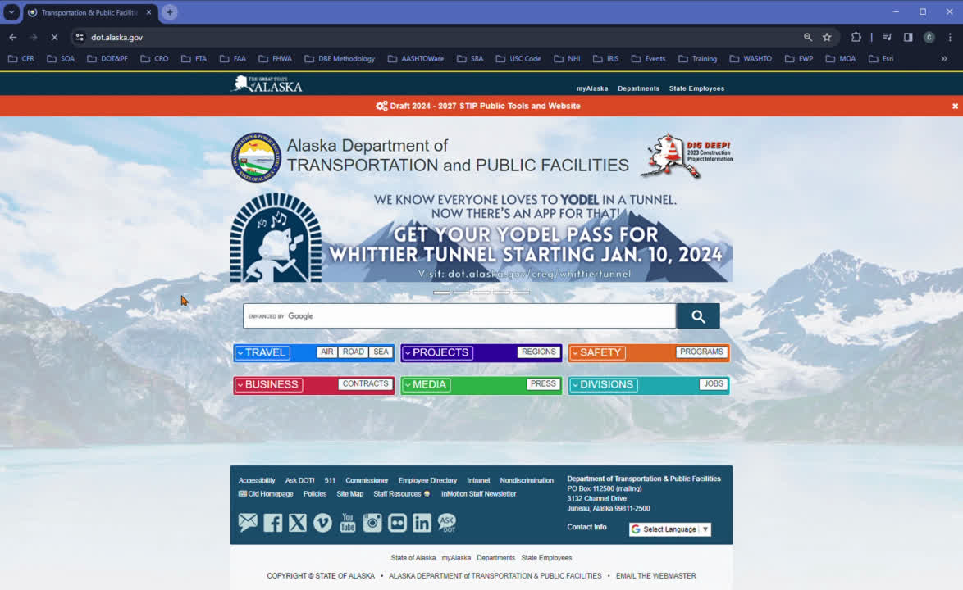
Where to find this form on the CRO website
HTTPS://DOT.ALASKA.GOV/CVLRTS/SS.SHTML

Slide 18
Where to submit this form
APPLICANTS CAN SUBMIT THEIR COMPLETED 50% DBE REIMBURSEMENT FORM ONE OF THE FOLLOWING WAYS:
DOT.CRO.PROJECTSDOCS@ALASKA.GOV
OR
NATALIA.FRICKE@ALASKA.GOV
Notes:
Applicants can submit their completed 50% DBE Reimbursement form one of the following ways:
Applicants can email us.
Applicants can submit the document using the State of Alaska Zendto/Drop Box. A note about Zendto: Applicants don’t need a username or password. Simply click “Drop-Off,” enter Name and Email Address. Applicants will get a link sent to their email with instructions on how to drop off files to desired email address.
Or you can Fax us!

Slide 19
Stay in the know!
VIEW OUR UPCOMING EVENTS AND MORE HERE: DOT.ALASKA.GOV/CVLRTS/EVENTS.SHTML
Notes:
The Civil Rights Office sends out annual emails and reminders about upcoming deadlines for 50% DBE Reimbursement as well as any other information like new forms, funding availability and so much more! Sign up for the email list serve by emailing DOT.CRO.ProjectsDocs@alaska.gov.
If you have any questions on this process, shoot us an email!

Slide 20
Contact Us!
EMAIL US AT: DOT.CRO.PROJECTSDOCS@ALASKA.GOV
Notes:
The Civil Rights Office sends out annual emails and reminders about upcoming deadlines for 50% DBE Reimbursement as well as any other information like new forms, funding availability and so much more! Sign up for the email list serve by emailing DOT.CRO.ProjectsDocs@alaska.gov.
If you have any questions on this process, shoot us an email!

